Slide 1
Acute tonsillitis. Chronic tonsillitis.

Slide 2
Acute tonsillitis primary (Angina).

Slide 3
Definition.
Angina is an infection disease with local manifestations in the form of acute inflammation of one or more components of the lymphadenoid pharyngeal ring, most often of the palatine tonsils.

Slide 4
Prevalence.
Acute primary tonsillitis is 3-7% of all recorded and 17-42% of all infectious forms. The prevalence of angina is highest in countries with a low level of socioeconomic development, with residents of cities being sick more often, this is due to the high density of the urbanized population. The outbreak of epidemics occurs in large groups.
According to I.N. Michalova (1976), age 70-100% of patients with angina 17-30 years.

Slide 5
Ways of transmission of infection.
Infection with angina occurs by airborne droplets. Sources of sore throat, patient, household items. Increased isolation of the infectious agent occurs when coughing and sneezing-106,000 microbial cells.
Infection is also possible from healthy carriers-in transport, classrooms, classrooms, sleeping rooms, barracks, etc. In large groups, the incidence is higher. The incidence in them increases after 2-8 weeks from the time of their renewal, i.e. "Newcomers" of the team get angina in 2-3 times more often.

Slide 6
Etiology.
The causative agent of angina can be:
-Bacteria;
-Virus;
-spirochets;
Crabs.
Among bacterial agents, b-hemolytic streptococcus is more common.
In the organized collectives - pneumacaccuses, meningococci, stick Influenza, Klebsiella.
The causative agent of viral sore throat is adenovirus 1-9 type, enterovirus Coxsackie, herpes virus.
Practically healthy people can be carriers of b-hemolytic streptococci.

Slide 7
Pathogenesis.
The entrance gate of infection is the lymphoid tissue of the oropharynx, where the primary focus of inflammation is formed. Predispose to the development of angina, general and local hypothermia, dusty or gassy atmosphere, increased dryness of the air, disruption of nasal breathing, hypovitaminosis, decreased immunity, etc. Most often, angina develops after a previous acute respiratory viral infection. Pathogens ARVI reduce the protective functions of the epithelial cover and contribute to the invasion of streptococci. Fixation of β-hemolytic streptococcus on the surface of tonsils and other clusters of lymphoid tissue is due to the affinity of a number of antigenic structures of the microbe, in particular lipoteichoic acid, to the epithelium of the lymphoid apparatus of the oropharynx. M-protein streptococci reduces the phagocytic activity of leukocytes at the site of the entrance gates and thereby contributes to the child's susceptibility to this disease. The pathogenic effect of streptococci is not limited to local damage leading to the development of angina. The products of the vital activity of streptococci (primarily toxins), getting into the blood, cause violations of thermoregulation, toxic damage to the nervous and cardiovascular systems, and can trigger immunopathological processes leading to the development of metatonzillar diseases (rheumatism, glomerulonephritis). Especially large is the risk of developing metatonzillar diseases with often recurrent streptococcal angina.

Slide 9
Classification.

Slide 10
Catarrhal.
Usually occurs in mild form: the onset of the disease is acute, the body temperature is subfebrile. General phenomena (headache, weakness, malaise, aches in the joints) are expressed moderately. The pain in the throat is insignificant. When examining the oropharynx: hyperemia of the mucous membrane of the palatine tonsils, palatine arches, soft palate; An increase in palatine tonsils, attacks are absent. Regional lymph nodes are enlarged slightly (up to 1 cm in diameter), moderately painful. In the analysis of blood: a small leukocytosis, an increase in ESR. Duration of the disease - 2-3 days. Can end with recovery or change into other forms. Recognize the streptococcal etiology of the disease is important for adequate therapy. Often it is necessary to differentiate catarrhal angina from viral pharyngitis, in which, unlike the bacterial process, there is often a cough, there may be a runny nose, there is no increase and soreness of the lymph nodes.

Slide 11
Follicular sore throat.
The condition of patients is moderate and severe: body temperature 38-39 ° C and above, symptoms of intoxication (chills, headache, pain in muscles and joints, pale skin, sleep and appetite disorders) are expressed. Intense pain in the throat. Children may have drowsiness, vomiting, convulsions, stool disruption. With mesopharyngoscopy: bright hyperemia and swelling of the mucous membranes of palatine arches and tonsils. The latter are enlarged in size, on the subepithelial surface, yellowish elevations (suppurated follicles) are visible. The tongue is white, dry. Regional lymph nodes are enlarged (1 cm in diameter and more), sharply painful. In the blood test: leukocytosis more than 12.0 × 109 g / l, neutrophil shift of formula to the left, accelerated ESR (20-50 mm / h). In the analysis of urine there may be traces of protein, microhematuria. In the first 2-3 days, the symptoms of the disease increase dramatically. From 3-4 days the festering follicles begin to disappear. The duration of the disease is 7-8 days.

Slide 12
Lacunar tonsillitis.
Clinically proceeds as a follicular sore throat. When examining the oropharynx: hyperemia of the mucosa of the palatine arch and tonsils. Palatine tonsils are enlarged in size. On their surface there are white-yellow raids located in the mouths of lacunae, they can merge with each other and cover the entire surface, they do not go beyond the tonsils, they are partially removed by a spatula, leaving no bleeding surfaces, rubbed between two spatulas or slides, dissolved in a vessel With water, creating dregs. The process may involve the side grooves of the pharynx, becoming edematous and hyperemic. Changes in laboratory parameters are similar to those in follicular angina. The duration of the disease is 7-8 days.

Slide 13
Ulcerative-Filamentous Angina of Simanovsky-Plaut-Vincent
It was first described in 1890 by N.N. Simanovsky. In 1898, Plaut and Vincent isolated the pathogens of this disease: spindle-shaped rod and spirochete of the oral cavity, which are a conditionally pathogenic flora of the oral cavity. Factors determining the development of the disease are immunodeficiency states, hypovitaminosis, cachexia, chronic intoxication. Moderate unilateral pain in the throat is characteristic. The temperature reaction is poorly expressed. The phenomena of intoxication are absent. There is regional lymphadenitis on the side of the lesion, bad breath. When mesopharyngoscopy (Figure 2): on one of the tonsils there is an ulcer covered with a gray-yellow coating, after removal of which clear edges of the ulcer are determined. Ulceration can extend beyond the tonsils to the soft palate, the oral mucosa, the posterior pharyngeal wall, the vestibular larynx and lead to bleeding, perforation of the palate, and periosteal injury. The duration of the disease is 7-12 days. To confirm the diagnosis, a bacteriological study is used (detection of fusospirillic flora). In controversial cases, an amygdala tissue biopsy is performed at the edge of the ulcer, followed by histological and cytological investigations.

Slide 14
Herpetic tonsillitis
The disease begins suddenly, usually with a rise in temperature to (38.5 - 40 ° C). Against the background of the rise in temperature, some patients may experience cramping pain in the abdomen, and possibly the occurrence of vomiting. The high temperature response is maintained, as a rule, for 2 - 4 days, and then falls critically.
Characteristic changes in the oral cavity and oropharynx. In the first days of the disease, reddening (hyperemia) of the mucous membrane of the palatine arch, tongue, soft and hard palate, and mucosa of the posterior pharyngeal wall is noted. Almost simultaneously, small papules (nodules) appear on the hyperemic background. The diameter of the papules is 2 - 3 mm. Later, the nodules undergo further evolutionary changes and turn into vesicles filled with cloudy contents.
The number of bubbles, as a rule, ranges from 15 to 20 elements. The appearance of the bubbles in the mouth cavity is accompanied by the attachment of the pain component during the swallowing act. In some cases, there is an intolerable, painful itching, profuse salivation, the oral mucosa easily injures and bleeds. After 3 - 4 days from the moment of its appearance, the vesicles are opened, exposing the defect of the mucous membrane - erosion. The bottom of the erosion is lined with fibrin, which causes its grayish white coating. Complete disappearance of pathological elements in the oral cavity is often observed in 7-10 days of the disease.
A typical sign of herpes sore throat is also an increase in submandibular, chin and other groups of lymph nodes.

Slide 15
Diagnostics.
Diagnosis of angina includes:
1) collection of complaints, anamnesis of disease and life;
2) clinical examination of the patient;
3) standard endoscopy of ENT organs;
4) bacteriological examination on BL (Laffler's bacillus) - smears from the pharynx and nose to diphtheria (by order No. 950 from 1996, examination for diphtheria for any raids on tonsils and paratonzillitis);
5) a general analysis of blood and urine;
6) bacteriological study (isolation of the culture of the pathogen from smears from the surface of the tonsils and / or the posterior pharyngeal wall);
7) Rapid detection of streptococcal antigen by means of test strips from the surface of the tonsils;
8) immunoserological study (determination of anti-streptolysin O (ASLO), anti-DNAase B or other anti-streptococcal antibodies).
The first four diagnostic measures are mandatory (the standard of medical research in angina), the rest are desirable. A general blood test is performed at the onset of the disease for differential diagnosis of primary and secondary acute tonsillitis.
After the transferred angina, taking into account the risk of complications, the following studies are shown:
1) a control study of blood and urine;
2) rheumatic tests (C-reactive protein, ASLO, seromucoid);
3) ECG;
4) consultations of specialists (according to indications): infectious diseases specialist, therapist, cardiorevmatologist, etc. Mandatory examinations at discharge are: examination of ENT organs, obtaining results of bacteriological examination from the pharynx and nose to BL, general analysis of blood and urine on the 7-10th Days of illness.

Slide 16
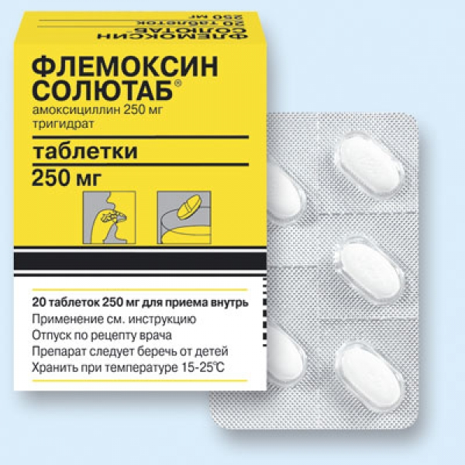
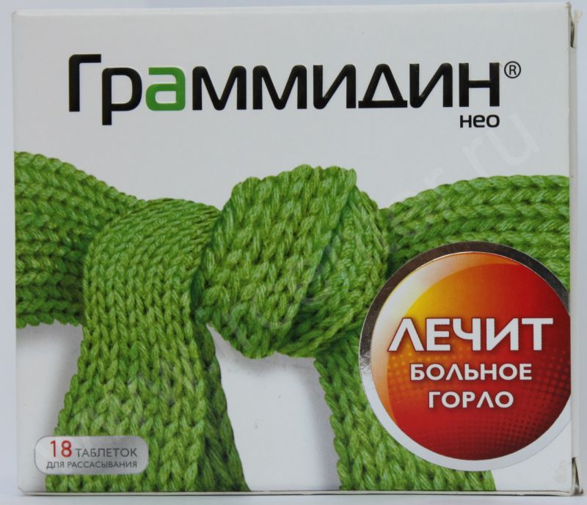
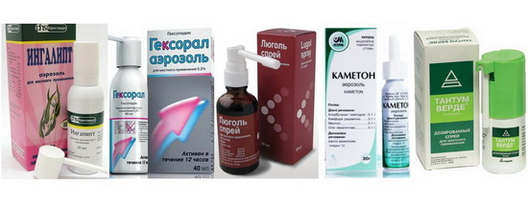
Treatment.

Slide 17
1. Home or stationary treatment, depending on the severity of the patient, social conditions. Hospitalization is carried out in an infectious hospital. In severe and moderately severe angina, when there is febrile body temperature, severe symptoms of intoxication - headache, weakness, abdominal pain, vomiting, shows infusion therapy and constant observation by a doctor.
2. Isolation of the patient (especially from children in the family).
3. Bed rest to reduce the load on the myocardium.
4. Gentle milk-vegetable vitaminized diet, it is necessary to exclude sharp, rough food - crackers, nuts, smoked sausages.

Slide 18
5. Antibiotic therapy. Given the natural high sensitivity of streptococcus to penicillins, penicillin drugs are used: noxymethylpenicillin 100 mg / kg / day in 4 doses, amoxicillin 30-60 mg / kg / day in 3 doses of 10 days.
You can use cephalosporins 1-2 generation: cefadroxil 30 mg / kg / day in 3 doses, cefuroxime axetil to children 20 mg / kg / day 2 times a day, adults - 500 mg 2 times a day. In the presence of allergic reactions to the above mentioned drugs, macrolides are prescribed: azithromycin 10 mg / kg / day in 1 reception 5 days, clarithromycin 15 mg / kg / day in 2 divided doses 10 days, roxithromycin 5 mg / kg / day 2 times a day, midecamycin 50 Mg / kg / day 3 times a day, josamycin 30-50 mg / kg / day 3 times a day for 10 days. If the patient received antibiotics in the previous month, the drug of choice is amoxicillin with clavulanic acid 40 mg / kg / day in 2-3 doses of 10 days. The method of administration of the drug depends on the severity of the disease: in severe cases (severe symptoms of intoxication in the form of febrile fever, adynamia, dyspnea), parenteral drugs are given (IV, IM). The same method of administration is indicated for swallowing disorders caused by a pain syndrome or a child's unwillingness to drink a medicine.

Slide 19
6. Detoxication therapy.
With a mild course of the disease - abundant warm drink: cranberry, cranberry fruit, mineral water, compotes. With severe course and development of complications - infusion therapy (glucose-salt solutions).
7. Non-steroidal anti-inflammatory agents as antipyretic and analgesic agents: Paracetamol 10 mg / kg, ibuprofen 5-10 mg / kg (nurofen), ketoprofen (ketonal, ketones), cefecon D (suppositories), analgin 50% 0.1 ml / year Life. 8. Antihistamines are prescribed only to patients with a tendency to allergic reactions (loratadine, desloratadine, cytisine).

Slide 20
9. Local anti-inflammatory treatment includes:
Rinsing of the oropharynx with 2% alkaline or saline solutions (1 teaspoon of soda or salt per glass of water), calendula, sage, chamomile, caragane, kashkara (1-2 tablespoons of vegetable raw materials per cup of boiling water). It is possible to use topical antiseptics and anesthetics in the form of ready-made dosage forms.
The weak analgesic effect of these drugs is carried out at the expense of menthol, the stronger is due to lidocaine, very good anesthesia is achieved with the help of local non-steroidal anti-inflammatory drugs (flurbiprofen), which are allowed to be used only from 18 years of age. The antiseptic action of local medicines depends on the composition of the components included in it (indicated below in parentheses).
Analgesics and antiseptics: Anti-angina (chlorhexidine, tetracaine, ascorbic acid), Hexaliz (biclotimol, enoxolone, lysozyme), Hexaspree (biclotimol), Grammidine (gramicidin, anesthetic), Drill (chlorhexidine, tetraquin), Cameton , Menthol, eucalyptus), Koldakt lorpils (amylmetacrezole, dichlorobenzyl), Neo-angin H (amyl methacresol, menthol), Pectussin (menthol, eucalyptus), Sepptole (benzalkonium, menthol, essential oils), Septogal (benzalkonium, menthol, ether Oils), Strepsils with lidocaine (amylmetacresol), Strepfen (flurbiprof (Benzodamine, menthol), TeraFlu Lar (benzoxonium chloride, lidocaine), Antiseptics: Bioparox (antibiotic fizafungin), Hexoral, Gramicidin (antibiotic gramicidin), Laripront (lysozyme and dequalinium), Lysobact (lysozyme), Lörpils ( Amyl methacresol, dichlorobenzyl), Miramistin, Octenisept, Proposol (propolis, glycerol, alcohol), Povidone-iodine, Rotokan (extracts of chamomile, calendula, yarrow), Romazulan (extract and camomile oil), Sebidine (chlorhexidine and ascorbic acid Acid), furacilin.

Slide 21
Prophylaxis and prognosis.
Specific prophylaxis is not developed. To prevent the spread of infection, timely isolation of patients with quinsy is of great importance. Individual prophylaxis consists in increasing the overall resistance of the organism (tempering), eliminating irritating factors (dust, smoke, excessive dryness of the air), timely sanitation of foci of chronic infection (with sinusitis, dental caries), eliminating causes that impede free breathing through the nose (curvature of the septum , Adenoids).

Slide 22
Forecast.
With catarrhal angina the forecast is favorable. With lacunar and follicular angina, the prognosis is also favorable, but after them, regardless of the severity of the flow, chronic tonsillitis often develops. After angina, caused by β-hemolytic group A streptococcus, regardless of the form of the disease, rheumatism and glomerulonephritis may develop.

Slide 23
Chronic tonsillitis and associated diseases

Slide 24
Definition.
Chronic tonsillitis (HT) is an infectious allergic disease with local manifestations in the form of a persistent inflammatory reaction of the tonsils, morphologically expressed by alteration, exudation and proliferation. (I.Soldatov)

Slide 25
Anatomy of the tonsils.
Morphological definition of the palatine tonsil includes:
A rounded shape is surrounded by a capsule;
The presence between the mucosa and capsule of lymph nodes and extrasound tissue;
The presence of epithelial crypts diffusely permeating the lymphadenoid tissue;
The presence of lymphoepithelial symbiosis in the crypt epithelium

Slide 26
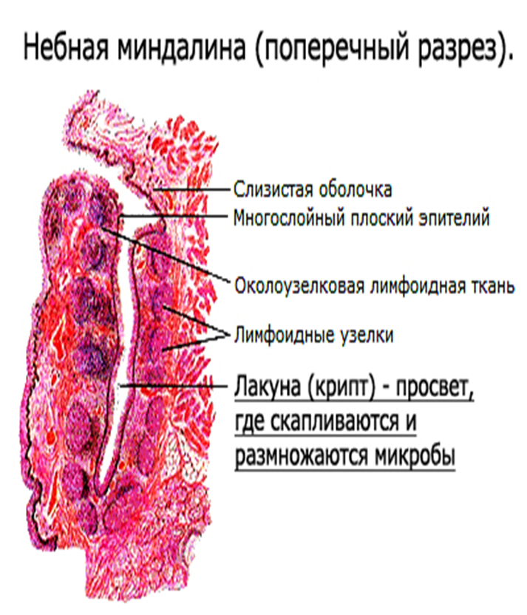

Slide 27
IV-lingualis (tonsilla lingyalis) is at the root of the tongue, referring to the laryngopharynx.
NB: Tubal tonsils (tonsilla tubaria) -these clusters are in the form of vertically directed lateral cords, are seen on the posterior wall of the oropharynx, medial to the posterior arch.

Slide 29
Functions of the tonsils.
1.Barrier function. Tonsils destroy microorganisms that enter the oral cavity with air, food, or are already in the body (caries, gingivitis, periodontitis, chronic tonsillitis). The role of the weapon is performed by macrophage cells, which are produced in the follicles of the tonsils.

Slide 30
2. Immunogenic function. In the follicles of the tonsils, white blood cells - T- and B-lymphocytes - ripen. These cells of the immune system play a major role in the body's immune defense. Lymphocytes produce various immunoglobulins (antibodies), which are responsible for a specific immune response of the body.

Slide 31
3. Functional function. Palatine tonsils are involved in oral digestion, namely, in the enzymatic activity carried out by lymphocytes emitting through the epithelium of the tonsils.

Slide 32
Conjugated with chronic tonsillitis. Chronic tonsillitis and rheumatism.
Rheumatism is a clinically diverse infectious and allergic disease characterized by a predominant lesion of the cardiovascular system, synovial, less often serous membranes and manifested by cyclic flow.
An undoubted role in the onset of the disease is given to b-hemolytic streptococcus.

Slide 33
Infectious-allergic process, underlying rheumatism, is closely related to focal, torpid streptococcal infection, localized more often in the palatine tonsils, and frequent tonsillitis, cause the allergic background that is necessary for the development of rheumatism.
Evidence:
-particular consecutive connection between rheumatism and angina;
-The frequency of chronic tonsillitis in patients with rheumatism;
-the favorable effect of tonsillectomy on the course of the rheumatic process.

Slide 34
Spindle-shaped rheumatic granulomas in the amygdala.

Slide 35
Chronic tonsillitis and nephritis.
Nephritis is regarded as an infectious-allergic disease, the etiological factor of which, is also group A streptococcus. It is proved:
The occurrence of nephritis after a previous streptococcal disease;
- detection of streptococcal antigen in the blood of patients with acute nephritis;
The presence of chronic tonsillitis contributes to the prolonged course of nephritis, and sometimes the transition of acute nephritis into a chronic, irreversible form.

Slide 36
Chronic tonsillitis and thyrotoxicosis.
-In connection with the anatomical proximity of the tonsils and thyroid gland, as well as the generality of the lymph circulation of the thyroid gland and the pharynx, I assume that pathologically altered palatine tonsils, which are a source of irritation, intoxication and allergization, cause an increased thyroid function and thereby increased production of thyroid-stimulating hormone.
-I think that the toxic substances that arise in chronic tonsillitis cause reflex (through the vegetative nervous system) thyroid dysfunction.
Chronic tonsillitis increases the manifestations of thyrotoxicosis and lengthens the period of treatment of the disease, so the prerequisite for the therapy of thyrotoxicosis is the removal of pathologically altered palatine tonsils.

Slide 37
Chronic tonsillitis and hypertension.
I believe that the pathologically altered palatine tonsils, often a source of intoxication and sensitization, affect the course of hypertension. Developing with angina swelling of the mucous membrane causes hypoxia of the brain, which leads to hypertension.
Other authors attach importance to the anatomical proximity of the tonsils to the sinocarotid zone, which regulates vascular tone.

Slide 38
Chronic tonsillitis and diabetes mellitus.
Diabetes mellitus is a disease in the pathogenesis of which the main role belongs to the decrease in the function of the islet apparatus of the pancreas with insufficient insulin production. Also in the development of diabetes is not an unimportant role assigned to infectious and inflammatory diseases, including spontaneous angina and exacerbation of chronic tonsillitis.
It is proved that in 62% of patients with diabetes mellitus with exacerbation of chronic tonsillitis there is an intensification of the symptoms of diabetes mellitus:
-thirst;
-general weakness;
Polyuria;
There were cases when after the transferred angina-a diabetic coma developed.
The question of surgical treatment of chronic tonsillitis in such patients is open. Tonsillectomy is a stress for the body, which can lead a patient with diabetes to acidosis and diabetic coma. It is believed that with the correct preparation of the patient (insulin therapy), the risk of postoperative complications is minimal.

Slide 39
Chronic tonsillitis and appendicitis.
Patients with appendicitis often suffer from chronic tonsillitis, and attacks of appendicitis often precede angina.
From anatomy it is known that at the base of the appendix there is a lymphadenoid tissue similar to that of the palatine tonsils, therefore, acute appendicitis could be called "appendical angina".

